Slide 1
From last lecture:
build data structures with hash pointers

Slide 2
linked list with hash pointers = “block chain”
H( )
prev: H( )
prev: H( )
prev: H( )
data
data
data
use case: tamper-evident log

Slide 3
detecting tampering
H( )
prev: H( )
prev: H( )
prev: H( )
data
data
data
use case: tamper-evident log

Slide 4
Tamper-evident log
The World’s Oldest Blockchain Has Been Hiding in the New York Times Since 1995
http://www.surety.com/
Cognate

Slide 5
binary tree with hash pointers = “Merkle tree”
H( ) H( )
H( ) H( )
H( ) H( )
H( ) H( )
H( ) H( )
H( ) H( )
H( ) H( )
(data)
(data)
(data)
(data)
(data)
(data)
(data)
(data)

Slide 6
proving membership in a Merkle tree
show O(log n) items
H( ) H( )
H( ) H( )
H( ) H( )
(data)

Slide 7
Advantages of Merkle trees
Tree holds many items
but just need to remember the root hash
Can verify membership in O(log n) time/space
Variant: sorted Merkle tree
can verify non-membership in O(log n)
(show items before, after the missing one)

Slide 8
More generally ...
can use hash pointers in any pointer-based
data structure that has no cycles
e.g. Directed acyclic graph (DAG; used in GHOST, IOTA, etc.)

Slide 9
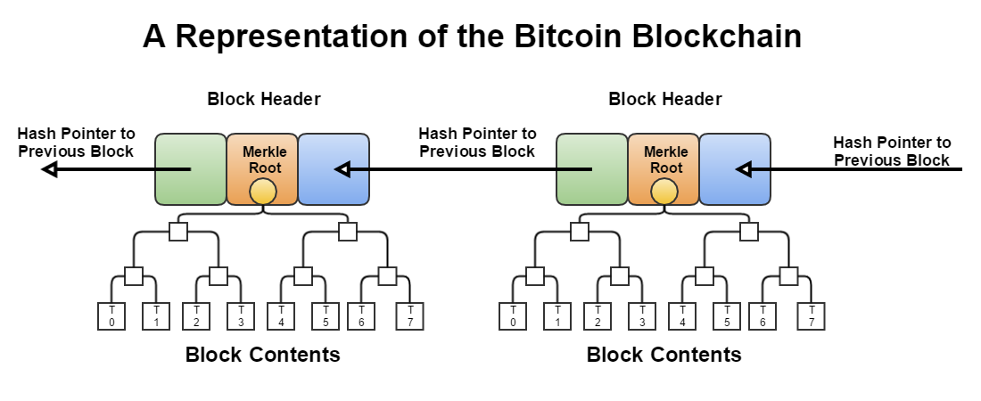

Slide 10
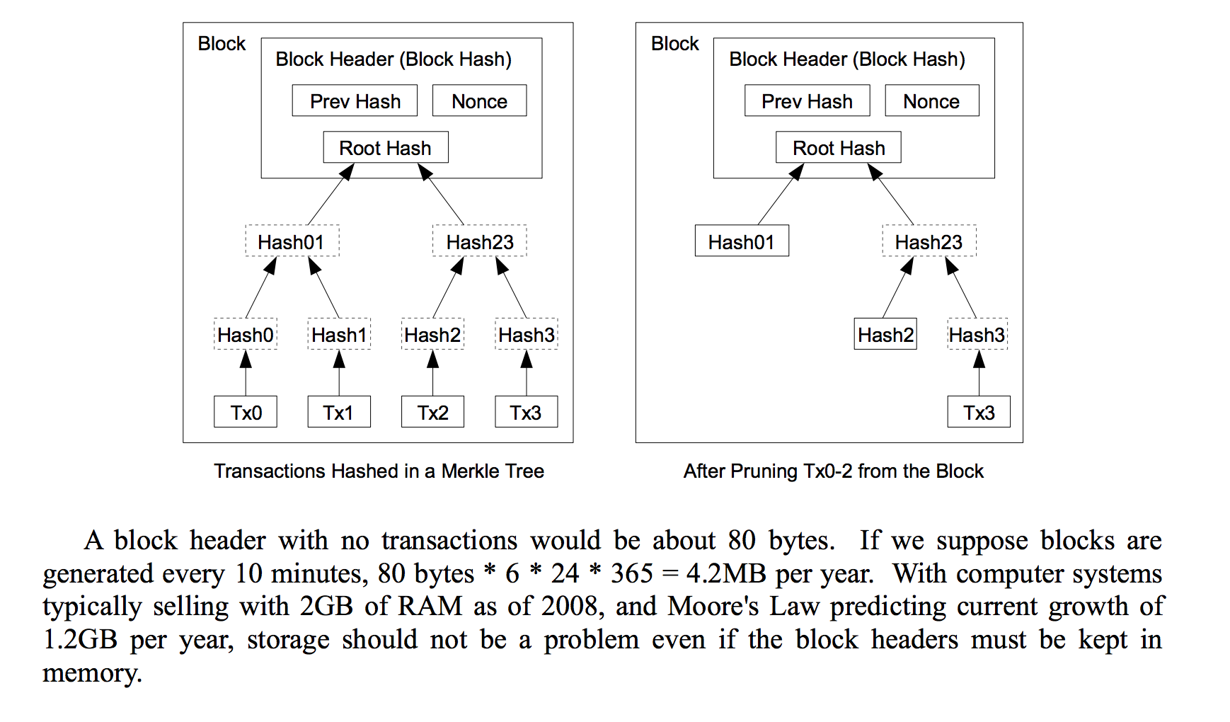
Reclaiming Space (Satoshi white paper)
https://blockchain.info/charts/blocks-size?timespan=all
1MB block size in practice

Slide 11
Lecture 1.3:
Digital Signatures

Slide 12
What we want from signatures
Recall what a check/contract looks like
Only you can sign, but anyone can verify
Signature is tied to a particular document
can’t be cut-and-pasted to another doc

Slide 13
API for digital signatures
(sk, pk) := generateKeys(keysize)
sk: secret signing key
pk: public verification key
sig := sign(sk, message)
isValid := verify(pk, message, sig)
can be
randomized
algorithms

Slide 14
Requirements for signatures
“valid signatures verify”
verify(pk, message, sign(sk, message)) == true
“can’t forge signatures”
adversary who:
knows pk
gets to see signatures on messages of his choice
can’t produce a verifiable signature on another message

Slide 15
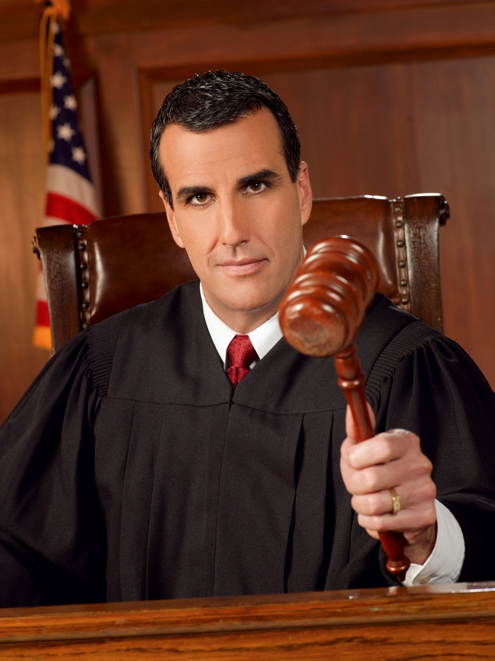
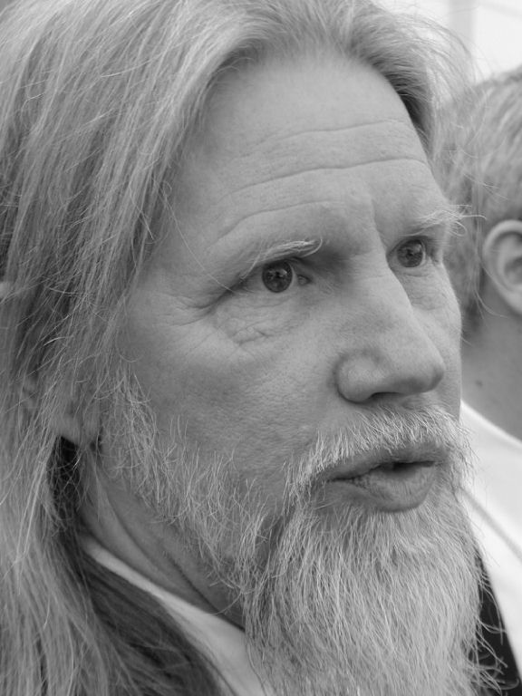
(sk, pk)
challenger
attacker
m₀
sign(sk, m₀)
m₁
sign(sk, m₁)
. . .
M, sig
M not in { m₀, m₁, … }
verify(pk, M, sig)
if true, attacker wins

Slide 16
Practical stuff...
algorithms are randomized
need good source of randomness
limit on message size
fix: use Hash(message) rather than message
fun trick: sign a hash pointer
signature “covers” the whole structure

Slide 17
Bitcoin uses ECDSA standard
Elliptic Curve Digital Signature Algorithm
relies on hairy math
will give a brief overview in the next slide
good randomness is essential
foul this up in generateKeys() or sign() ?
probably leaked your private key

Slide 18
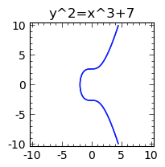
http://www.coindesk.com/math-behind-bitcoin/
more background: https://www.youtube.com/watch?v=4M8_Oo7lpiA
Notes:
http://www.coindesk.com/math-behind-bitcoin/

Slide 19
Lecture 1.4:
Public Keys as Identities

Slide 20
Useful trick: public key == an identity
if you see sig such that verify(pk, msg, sig)==true,
think of it as
pk says, “[msg]”.
to “speak for” pk, you must know matching secret key sk

Slide 21
How to make a new identity
create a new, random key-pair (sk, pk)
pk is the public “name” you can use
[usually better to use Hash(pk)]
sk lets you “speak for” the identity
you control the identity, because only you know sk
if pk “looks random”, nobody needs to know who you are

Slide 22
Decentralized identity management
anybody can make a new identity at any time
make as many as you want!
no central point of coordination
These identities are called “addresses” in Bitcoin.

Slide 23
1KxRrFXyLo2d4P1toMizuP4g1HriieZjMM

Slide 24
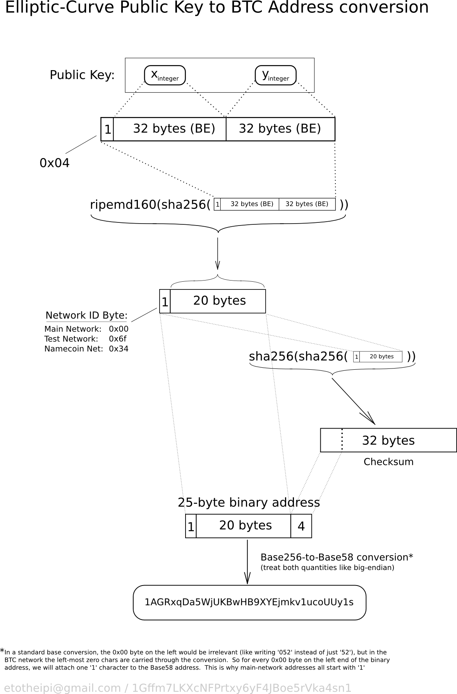

Slide 25
Privacy
Addresses not directly connected to real-world identity.
But observer can link together an address’s activity over time, make inferences.
Later (maybe): a whole lecture on privacy in Bitcoin ...

Slide 26
Lecture 1.5:
Simple Cryptocurrencies

Slide 27
GoofyCoin

Slide 28
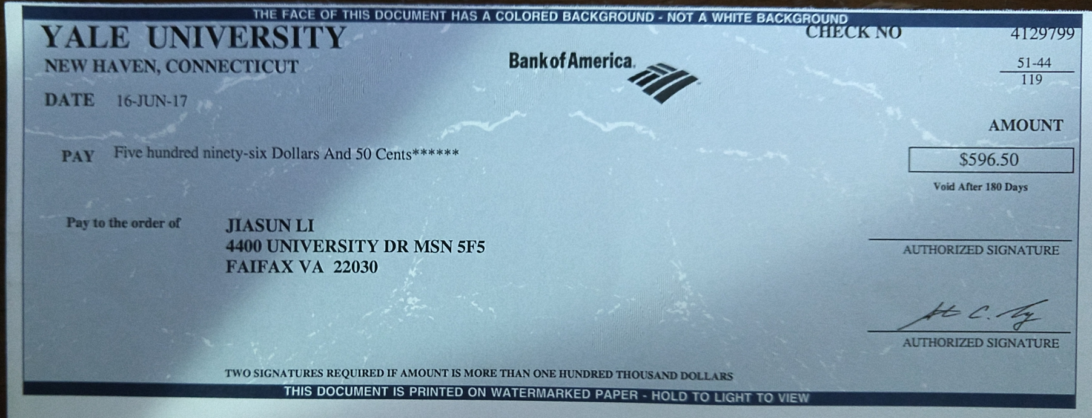

Slide 29
Goofy can create new coins
New coins belong to me.
signed by pk_{Goofy}
CreateCoin [uniqueCoinID]

Slide 30
A coin’s owner can spend it.
Alice owns it now.
signed by pk_{Goofy}
Pay to pk_{Alice} : H( )
signed by pk_{Goofy}
CreateCoin [uniqueCoinID]

Slide 31
The recipient can pass on the coin again.
signed by pk_{Alice}
Bob owns it now.
Pay to pk_{Bob} : H( )
signed by pk_{Goofy}
Pay to pk_{Alice} : H( )
signed by pk_{Goofy}
CreateCoin [uniqueCoinID]

Slide 32
Recall about a check again!

Slide 33
double-spending attack
signed by pk_{Alice}
signed by pk_{Alice}
Pay to pk_{Bob} : H( )
Pay to pk_{Chuck} : H( )
signed by pk_{Goofy}
Pay to pk_{Alice} : H( )
signed by pk_{Goofy}
CreateCoin [uniqueCoinID]

Slide 34
double-spending attack
the main design challenge in digital currency

Slide 37
ScroogeCoin

Slide 39
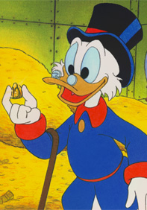
Scrooge publishes a history of all transactions
(a block chain, signed by Scrooge)
H( )
prev: H( )
prev: H( )
prev: H( )
transID: 71
transID: 72
transID: 73
trans
trans
trans
optimization: put multiple transactions in the same block

Slide 40
CreateCoins transaction creates new coins
Valid, because I said so.
transID: 73 type:CreateCoins
coins created
num | value | recipient
0 | 3.2 | 0x...
1 | 1.4 | 0x...
2 | 7.1 | 0x...
coinID 73(0)
coinID 73(1)
coinID 73(2)

Slide 41
PayCoins transaction consumes (and destroys) some coins,
and creates new coins of the same total value
transID: 73 type:PayCoins
consumed coinIDs:
68(1), 42(0), 72(3)
Valid if:
-- consumed coins valid,
-- not already consumed,
-- total value out = total value in, and
-- signed by owners of all consumed coins
coins created
num | value | recipient
0 | 3.2 | 0x...
1 | 1.4 | 0x...
2 | 7.1 | 0x...
signatures

Slide 42
Immutable coins
Coins can’t be transferred, subdivided, or combined.
But: you can get the same effect by using transactions
to subdivide: create new trans
consume your coin
pay out two new coins to yourself

Slide 43
Don’t worry, I’m honest.
Crucial question:
Can we descroogify the currency, and operate without any central, trusted party?

